Slide 1


Slide 2
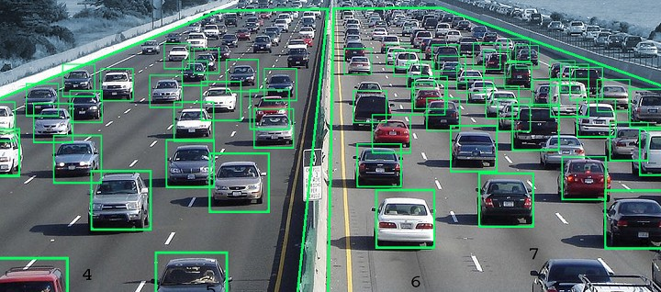
Vehicle detection system
Vehicle detection using OpenCV refers to the process of identifying and locating vehicles in images or video streams using the OpenCV library, which is a popular computer vision and machine learning library in Python. This technique involves applying various image processing and computer vision algorithms to detect vehicles accurately.
Vehicle detection plays an important role in safe driving assistance technology.
Smart Traffic light system

Slide 3
Block Diagram – Workflow
Loading HaarCascade
Algorithm
Initializing Camera
Reading Frame from Camera
Converting Color image into Grayscale Image
Obtaining Car coordinates by passing algorithm
Drawing Rectangle on the Car Coordinates
Display the output Frame

Slide 4




THANK YOU☺
NOVITECH COIMBATORE
novitechresearchanddevelopment

